Slide 1
DIGITAL PORTFOLIO
NAME:Vishnu Varadhan.B
REGISTER NO & NMID: 212400982/227277BE4CDF7CC945D4763CE6BC9F04
DEPARTMENT: II BCA B
COLLEGE: Prince Shri Venkateshwara Arts and Science College / Madras University

Slide 2
Project Title
📌 Digital Portfolio

Slide 3
Agenda
Problem Statement
Project Overview
End Users
Tools & Technologies
Portfolio Layout & Design
Features & Highlights
Results & Demonstrations
Conclusion
GitHub Repository

Slide 4
Problem Statement
Resumes and CVs often fail to demonstrate creativity and technical skills.
Many students face difficulty showcasing projects effectively.
A professional online space can help present skills in a structured way.
A digital portfolio provides visibility and helps in building personal branding.

Slide 5
Project Overview
A modern portfolio website designed to:
Highlight academic records and certifications
Showcase technical abilities
Present completed projects with details
Provide contact and networking options
Focused on responsive design and easy accessibility.
Acts as a bridge between students and recruiters.

Slide 6
End Users
Hiring Managers & Recruiters – Quick skill evaluation.
Employers – Selecting candidates for roles.
Educational Institutes – For internships and project reviews.
Peers – For collaboration and networking.
Clients – To check professional competence before hiring.

Slide 7
Tools & Technologies
Frontend – HTML, CSS, JavaScript
Frameworks – Bootstrap / Tailwind CSS
Version Control – Git, GitHub
Design Principle – Responsive & User-Centered Design
Extras – Simple animations and icons for better UI

Slide 8
Portfolio Design & Layout
Sections included:
About Me – Career goals and personal summary
Skills – Technical expertise and software knowledge
Projects – Case studies with descriptions & images
Contact Me – Email, LinkedIn, GitHub
Design Highlights:
Consistent and professional theme
Smooth transitions and user-friendly navigation
Optimized for all screen sizes

Slide 9
Features & Highlights
Responsive design for all devices
Interactive project showcase
Smooth menu navigation
Contact form & social media links
Easy customization for updates
Simple UI for better user experience

Slide 10
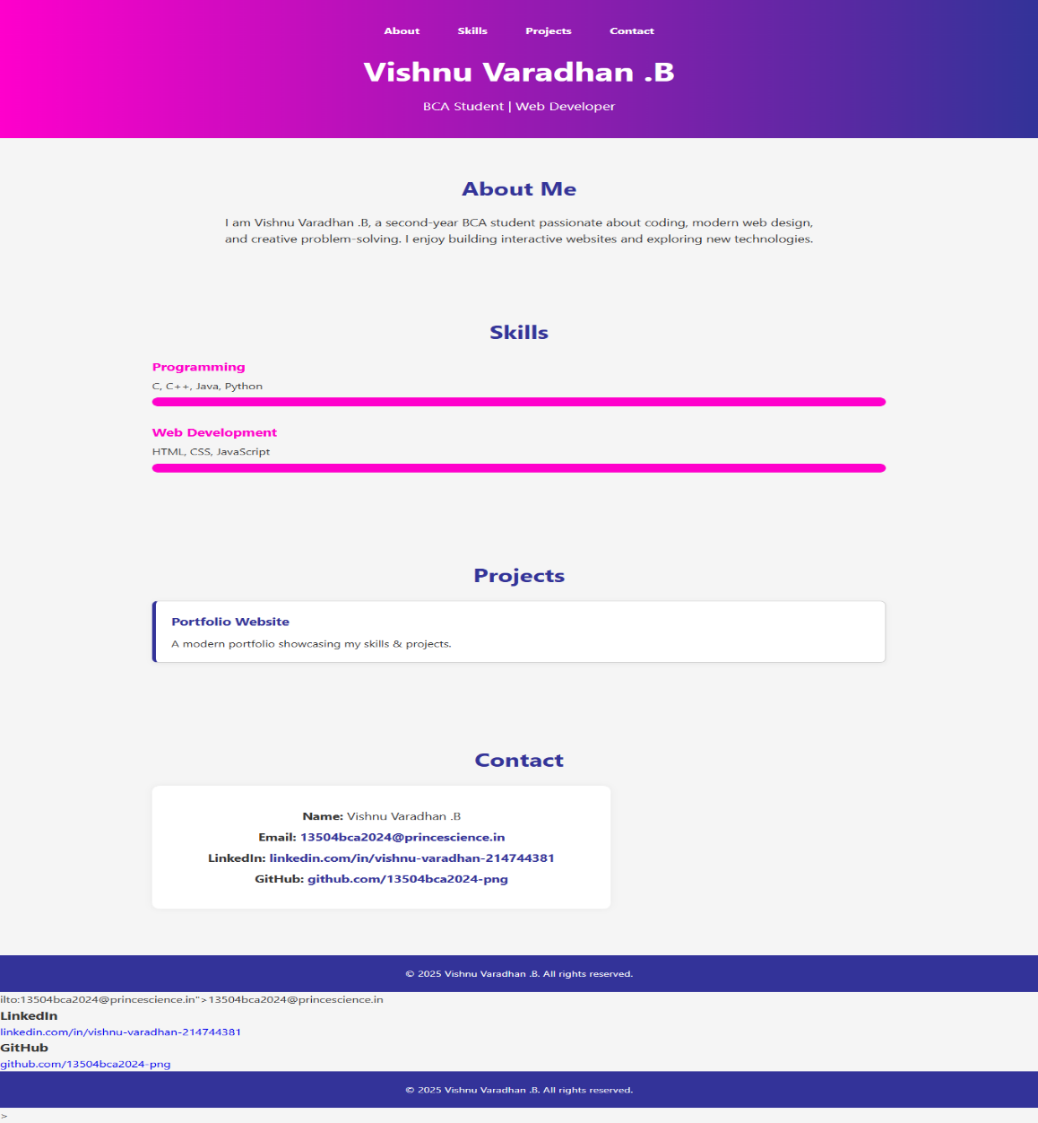
Results & Screenshot

Slide 11
Conclusion
A digital portfolio enhances career opportunities.
Provides an organized platform to showcase talents.
Supports long-term personal branding.
Future Plans:
Add certificate gallery
Include testimonials/references
Advanced animations and blog section

Slide 12
GitHub Link
https://13504bca2024-png.github.io/My-portfolio/

